Slide 1
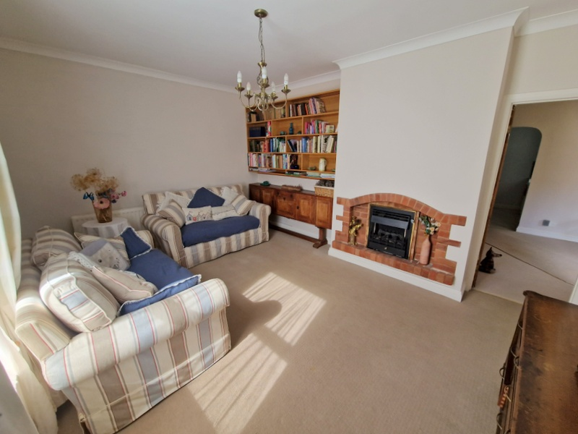
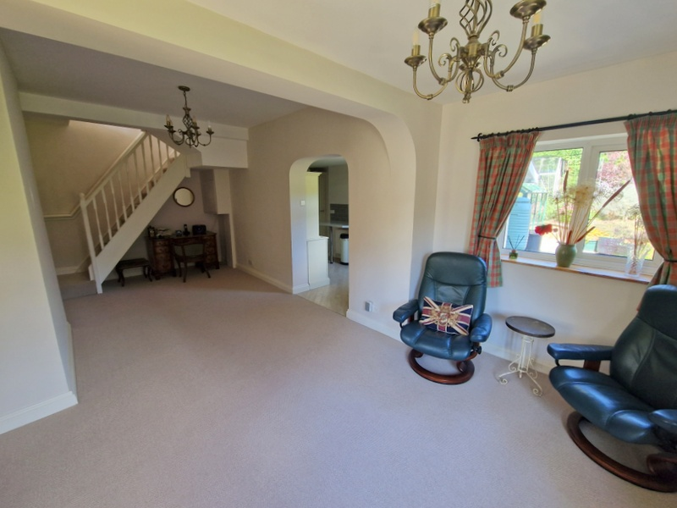
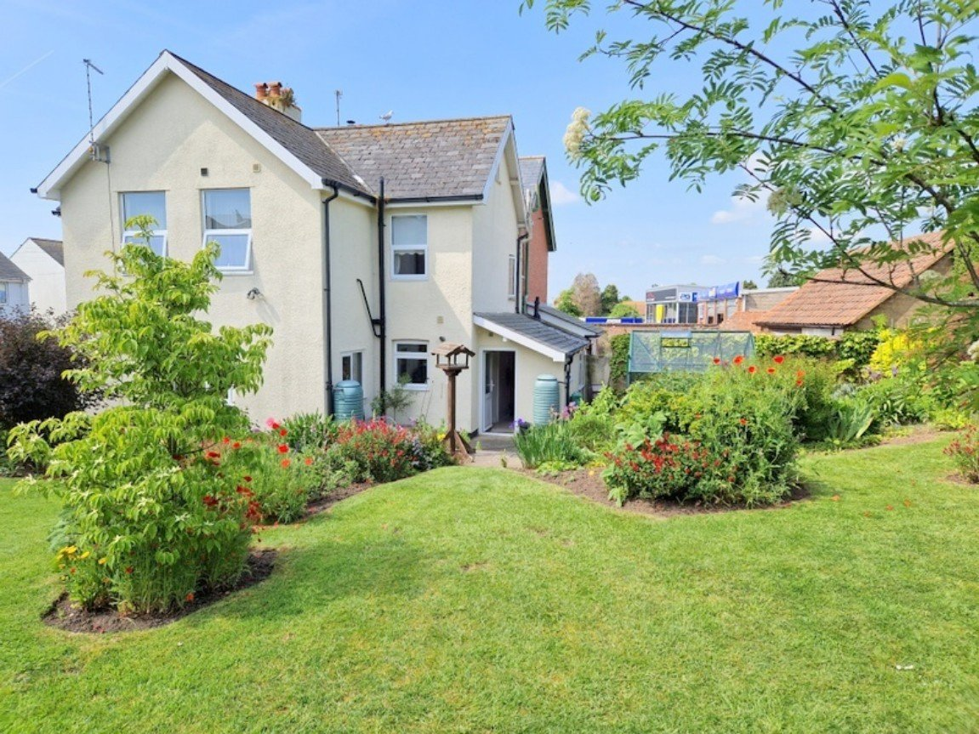
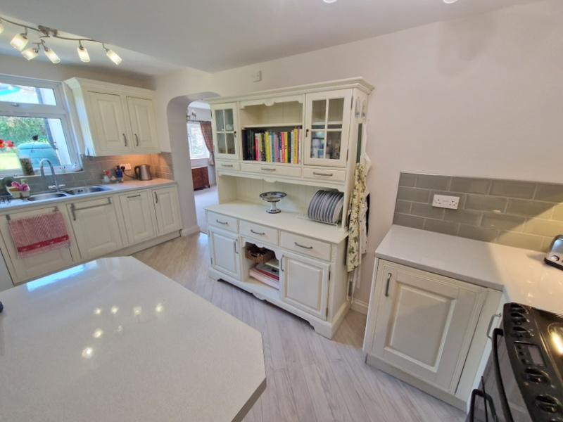
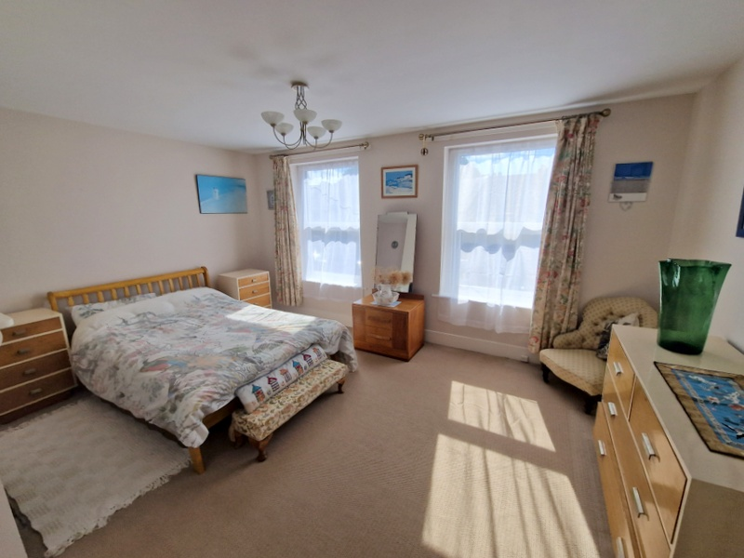
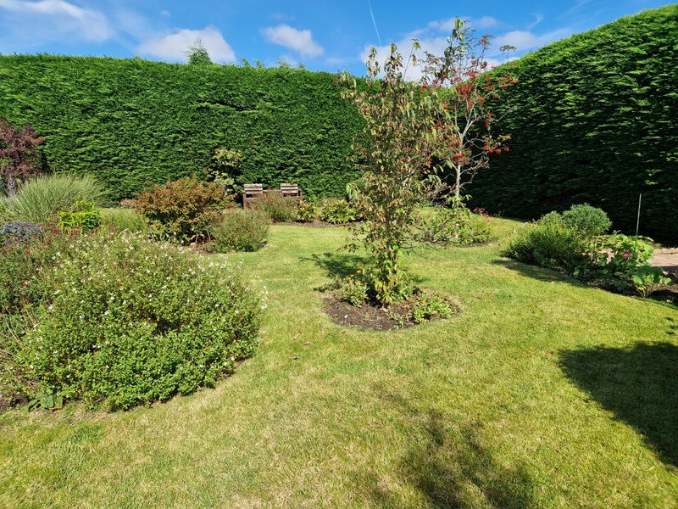
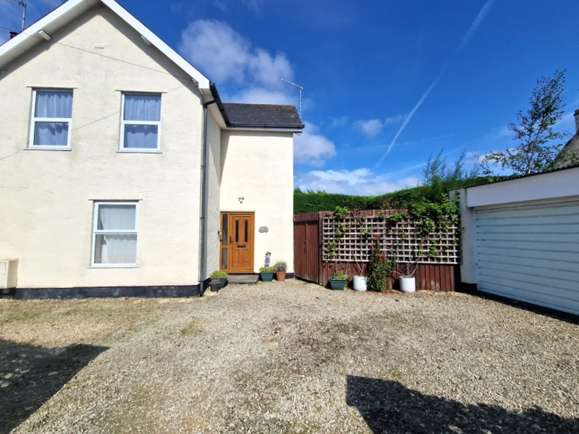
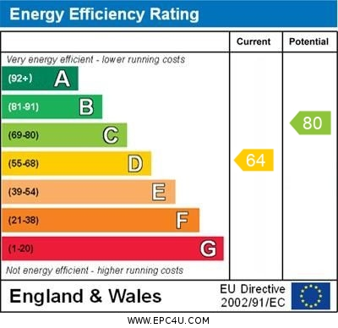
www.pennys.net
245 Withycombe Village Road, Exmouth, Devon, EX8 3BD
GUIDE PRICE £499,950
TENURE Freehold
A Well Presented And Deceptively Spacious Semi-Detached Period House With Wonderful Generously Sized Gardens,
Ample Off-Road Parking And Double Garage
Entrance Vestibule • Good Size Lounge • Separate Family/Dining Room •
Kitchen/Breakfast Room • Utility Room • Rear Lobby/Garden Room • Ground Floor Cloakroom/WC • Three First Floor Bedrooms - One With En-Suite Shower Room/WC
Main Family Bathroom • Double Glazed Windows • Gas Central Heating Via Modern Boiler * Viewing Highly Recommended • No Onward Chain
Pennys Estate Agents Limited for themselves and for the vendor of this property whose agents they are give notice that:- (1) These particulars do not constitute any part of an offer or a contract. (2) All statements contained in these particulars are made without responsibility on the part of Pennys Estate Agents Limited. (3) None of the statements contained in these particulars are to be relied upon as a statement or representation of fact. (4) Any intending purchaser must satisfy himself/herself by inspection or otherwise as to the correctness of each of the statements contained in these particulars. (5) The vendor does not make or give and neither do Pennys Estate Agents Limited nor any person in their employment has any authority to make or give any representation or warranty whatever in relation to this property.
PENNYS ESTATE AGENTS
2 Rolle House, Rolle Street, Exmouth, Devon, EX8 2SN
Tel: 01395 264111 EMail: help@pennys.net

Slide 2
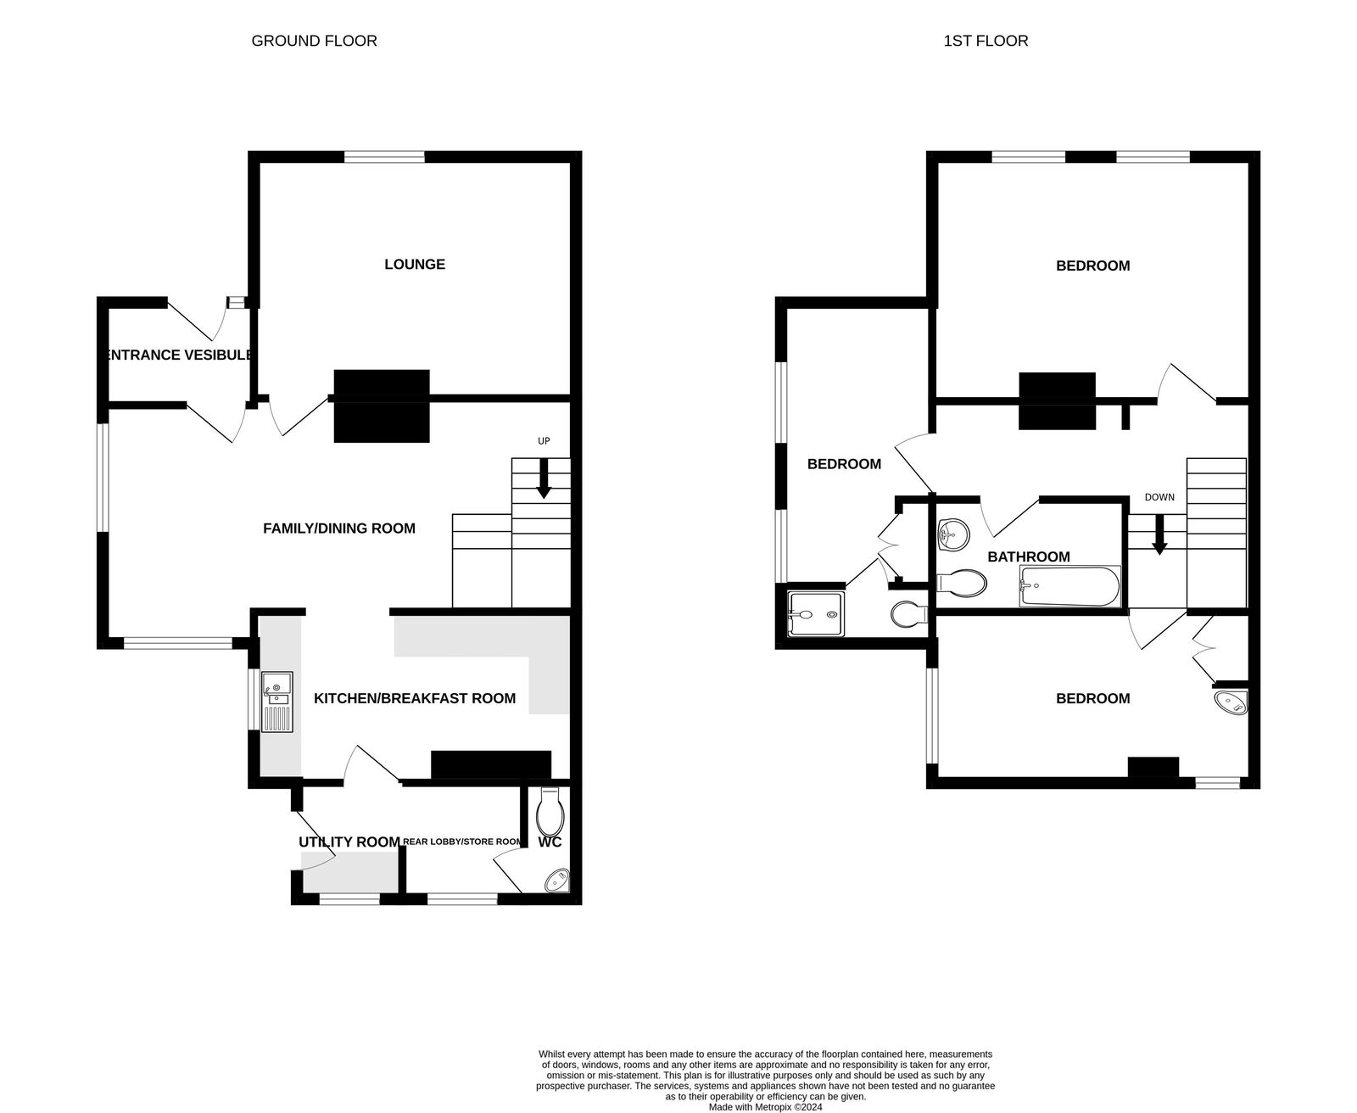
245 Withycombe Village Road, Exmouth, Devon, EX8 3BD
THE ACCOMMODATION COMPRISES: Wood Effect uPVC front door with patterned glass window inset and matching picture window side screen giving access to:
ENTRANCE VESTIBULE: - 2.21m x 1.42m (7'3" x 4'8") Radiator; electric consumer unit; glazed panelled inner door with patterned glass leading to the family/dining room.
LOUNGE: - 4.72m x 3.53m (15'6" x 11'7") Double glazed window to front aspect; gas fire set in chimney recess with feature exposed brick surround; radiator; coved ceiling, door leading to the family/dining room:
FAMILY/DINING ROOM: - 7.24m x 3.51m (23'9" x 11'6") narrowing to 3.05m (10'0"). A spacious room with two sets of uPVC double glazed windows overlooking the gardens; two radiators; television point; thermostat control for central heating; staircase rising to the first floor landing; glazed panelled door leading through an archway to the kitchen/breakfast room.
KITCHEN/BREAKFAST ROOM: - 4.75m x 2.44m (15'7" x 8'0") Fitted with a range of gloss finish patterned work top surfaces with tiled surrounds and incorporating a breakfast bar area; inset double bowl single drainer sink unit with chrome swan neck mixer tap over; range of base cupboards, drawer units and matching wall mounted glass-front display units; space for dishwasher; upright larder style cupboard; electric cooker point with stainless steel chimney style extractor hood over with light; modern gas boiler serving domestic hot water and central heating; double glazed window overlooking the rear garden; glazed panelled door to:
UTILITY ROOM: - 1.78m x 1.68m (5'10" x 5'6") Fitted with gloss finish pattered work top surface with space and plumbing for washing machine beneath; radiator; uPVC double glazed rear door with patterned glass giving access to the gardens; opening to:
REAR LOBBY/STORE ROOM: - 2.29m x 1.65m (7'6" x 5'5") Double glazed window with patterned glass; radiator; door to:
GROUND FLOOR CLOAKROOM/WC: Comprising of a wash hand basin with tiled splashback; WC with push button flush; fitted shelving; extractor fan.
FIRST FLOOR SPLIT LEVEL LANDING: Fitted shelving in inner landing area; access to:
BEDROOM ONE: - 4.7m x 3.53m (15'5" x 11'7") A bright room with two sets of double glazed windows to front aspect; feature cast iron fireplace with wooden surround; radiator.
BEDROOM TWO: - 3.94m x 2.44m (12'11" x 8'0") A fine guest bedroom with two sets of double glazed windows overlooking the gardens; radiator; built-in double wardrobe with clothes rail and shelving.
EN-SUITE SHOWER ROOM/WC: Stylishly fitted and comprising of a good size shower cubicle with push button chrome shower unit; space saver wash hand basin with cupboard beneath; WC with push button walls; chrome heated towel rail; splashback walls and colour coordinated flooring; recess ceiling spotlighting; ceiling light/extractor.
BEDROOM THREE: - 4.78m x 2.44m (15'8" x 8'0") Another good size bedroom with double glazed window overlooking the rear garden; further double glazed window with patterned glass; radiator; dado rail; bespoke designed bedside shelving units; access to roof space; wash hand basin with splashback and cabinet beneath; airing cupboard housing water cylinder with shelving over.
MAIN BATHROOM/WC: - 2.92m x 1.63m (9'7" x 5'4") A modern suite comprising of bath with shower unit over, shower curtain and rail; pedestal wash hand basin; WC with push button flush; chrome heated towel rail; attractive tiling to dado rail height; colour coordinated tiled flooring; recess ceiling spotlighting.
OUTSIDE: To the front of the property there is a gravelled driveway providing off-road parking and leading to a DOUBLE GARAGE. The REAR GARDEN is a wonderful feature of the property being generous in size and offering an abundance of colour from a variety of flowers, shrubs and trees. The garden is fully enclosed and offers a high degree of privacy and seclusion. Comprising of a large patio sun terrace area ideal for al-fresco dining/entertaining; extensive area of lawned garden; greenhouse; further garden store with patio area directly in front; outside lighting; outside cold water tap.
DOUBLE GARAGE: - 5.97m x 4.88m (19'7" x 16'0") With up and over door; fluorescent lighting; part glazed door giving direct access into the rear garden.
Mortgage Assistance: We are pleased to recommend Meredith Morgan Taylor, who would be pleased to help no matter which estate agent you finally buy through. For a free initial chat please contact us on 01395 264111 to arrange an appointment. Your home may be repossessed if you do not keep up repayments on your mortgage. Meredith Morgan Taylor Ltd is an appointed representative of Openwork Limited, a trading style of Openwork Ltd which is authorised and regulated by the Financial Conduct Authority (FCA).
FLOOR PLAN:

